Slide 1
INFERTILITY AND ITS MANAGEMENT
DR. THILINA PALIHAWADANA

Slide 2
LEARNING OBJECTIVES
WHAT IS INFERTILITY?
WHAT ARE THE CAUSES OF INFERTILITY?
HOW TO INVESTIGATE FOR AETIOLOGY IN INFERTILITY?
HOW TO TREAT INFERTILITY?
HOW TO DEVELOP A MANAGEMENT PLAN FOR A COUPLE WITH INFERTILITY?

Slide 3
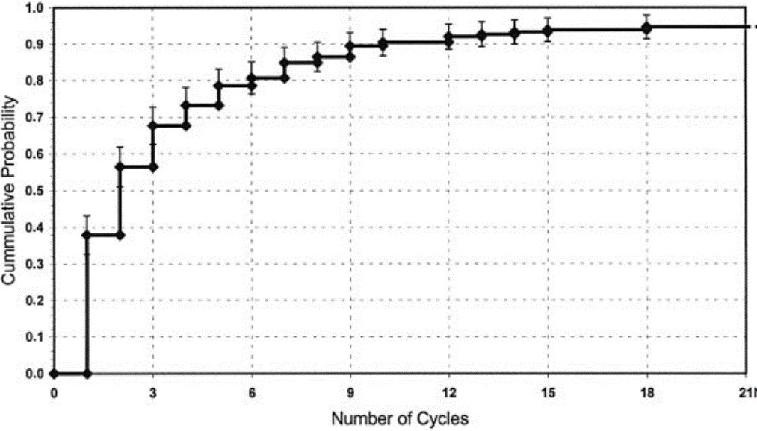
WHAT IS INFERTILITY
A COUPLE’S INABILITY TO CONCEIVE AFTER 1 YEAR OF UNPROTECTED INTERCOURSE
DEFINE WHEN TO INVESTIGATE AND TREAT

Slide 4
WHAT IS INFERTILITY
EARLIER INVESTIGATIONS FOR
ADVANCED AGE
FEATURES SUGGESTIVE OF ABNORMALITY
CONDITIONS AFFECTING FERTILITY
SOCIAL / PERSONAL REASONS

Slide 5
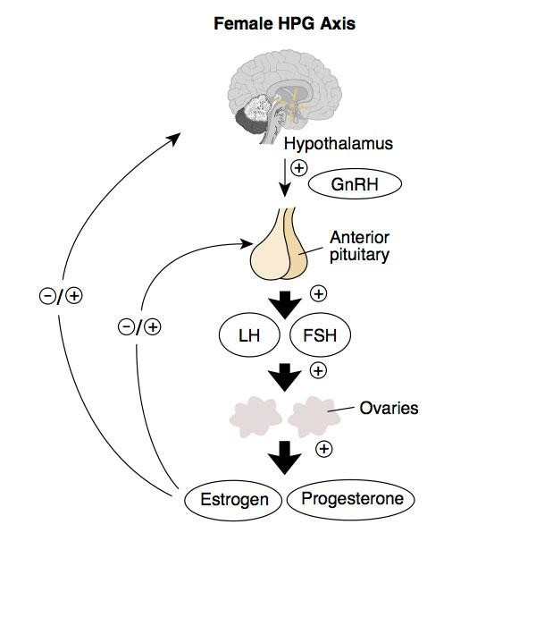
WHAT ARE THE CAUSES OF INFERTILITY?
REQUIREMENTS FOR FERTILITY
OVULATION

Slide 6
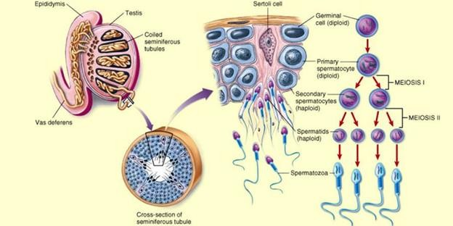
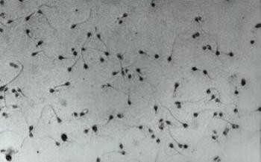
WHAT ARE THE CAUSES OF INFERTILITY?
REQUIREMENTS FOR FERTILITY
OVULATION
NORMAL SEMEN PARAMETERS

Slide 7
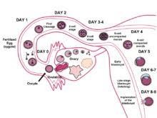
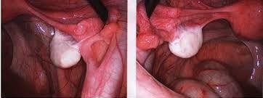
WHAT ARE THE CAUSES OF INFERTILITY?
REQUIREMENTS FOR FERTILITY
OVULATION
NORMAL SEMEN PARAMETERS
NORMAL SEXUAL FUNCTIONS
PATENT AND FUNCTIONAL FALLOPIAN TUBES
NORMAL PELVIS

Slide 8
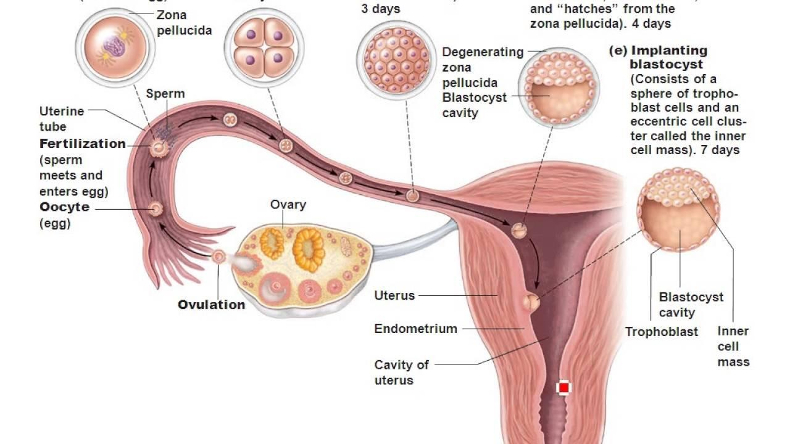
WHAT ARE THE CAUSES OF INFERTILITY?
REQUIREMENTS FOR FERTILITY
OVULATION
NORMAL SEMEN PARAMETERS
NORMAL SEXUAL FUNCTIONS
PATENT AND FUNCTIONAL FALLOPIAN TUBES
NORMAL PELVIS
NORMAL UTERUS AND ENDOMETRIUM

Slide 9
WHAT ARE THE CAUSES FOR INFERTILITY
ANOVULATION OR OVULATORY DYSFUNCTION
HYPOGONADOTROPIC HYPOGONADISM
HYPERGONADOTROPIC HYPOGONADISM
NORMOGONADOTROPIC HYPOGONADISM

Slide 10
WHAT ARE THE CAUSES FOR INFERTILITY
SEMINAL FLUID ABNORMALITIES
ANEJACULATION
ABNORMAL VOLUME, COUNT, MOTILITY, MORPHOLOGY, VIABILITY
AZOOSPERMIA

Slide 11
WHAT ARE THE CAUSES FOR INFERTILITY
FREQUENCY
REGULARITY
PENETRATION
EJACULATION
SEXUAL DYSFUNCTION

Slide 12
WHAT ARE THE CAUSES FOR INFERTILITY
FALLOPIAN TUBE ABNORMALITIES
BLOCKED TUBES
SCARRED TUBES
PERITUBAL ADHESIONS
PELVIC DISEASE
ENDOMETRIOSIS
PID

Slide 13
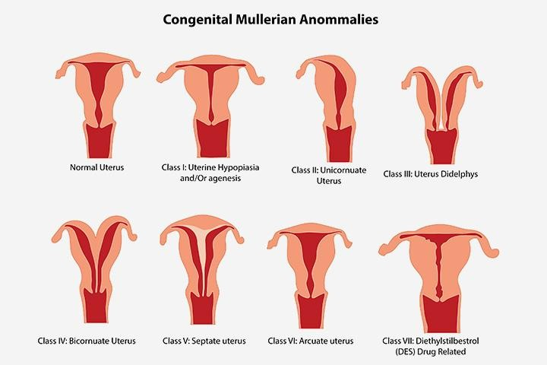
WHAT ARE THE CAUSES FOR INFERTILITY
UTERINE ABNORMALITIES
CONGENITAL ABNORMALITIS
SEPTATE UTERUS
UTERINE AGENSIS
FIBROIIDS
POLYPS
ABNORMAL ENDOMETRIUM
TB, INFECTION,
ASHERMAN’S SYNDROME

Slide 14
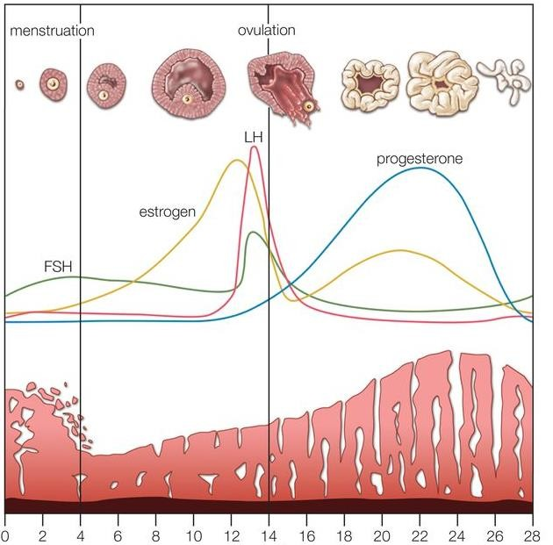
HOW TO INVESTIGATE FOR AETIOLOGY?
MIDLUTEAL PROGESTERONE LEVEL
USS FOLLICLE TRACKING
ANOVULATION
BBT
LH SURGE

Slide 15

HOW TO INVESTIGATE FOR AETIOLOGY?
SEMINAL FLUID ABNORMALITIES
SEMINAL FLUID ANALYSIS
SPERM FUNCTIONAL TESTS

Slide 16

HOW TO INVESTIGATE FOR AETIOLOGY?
SEXUAL DYSFUNCTION
MAINLY BY HISTORY
LOW FREQUENCY
LACK OF LIBIDIO
IRREGULAR INTERCOURSE
WORK COMMITMENTS
NON-PENETRATIVE SEX
ED
EJACULATORY PROBLEMS
PREMATURE, RETROGRADE

Slide 17
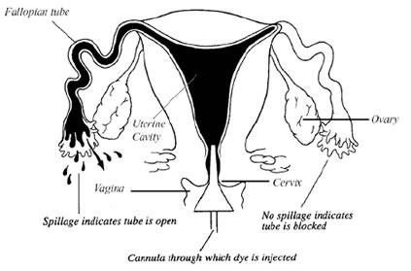
HOW TO INVESTIGATE FOR AETIOLOGY?
HYSTEROSALPINGOGRAM (HSG)
LOOK AT THE OUTLINE OF UTERUS AND TUBES
PATENCY OF TUBES CAN BE DEMONSTRATED
TUBAL DISEASE

Slide 18
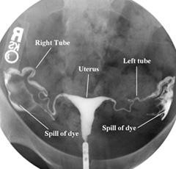
HOW TO INVESTIGATE FOR AETIOLOGY?
HYSTEROSALPINGOGRAM (HSG)
LOOK AT THE OUTLINE OF UTERUS AND TUBES
PATENCY OF TUBES CAN BE DEMONSTRATED
TUBAL DISEASE

Slide 19
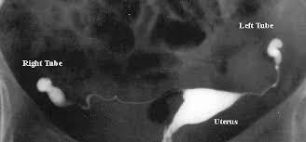
HOW TO INVESTIGATE FOR AETIOLOGY?
HYSTEROSALPINGOGRAM (HSG)
LOOK AT THE OUTLINE OF UTERUS AND TUBES
PATENCY OF TUBES CAN BE DEMONSTRATED
TUBAL DISEASE

Slide 20
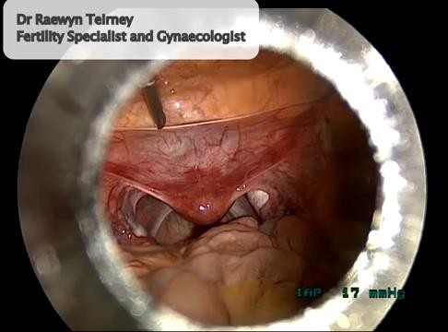
HOW TO INVESTIGATE FOR AETIOLOGY?
LAPAROSCOPY AND DYE TEST
ASSESS TUBES AND PELVIS
WHEN PELVIC DISEASE IS SUSPECTED
CORRECTIVE SURGERY ALSO AT THE SAME TIME.
TUBAL DISEASE

Slide 21
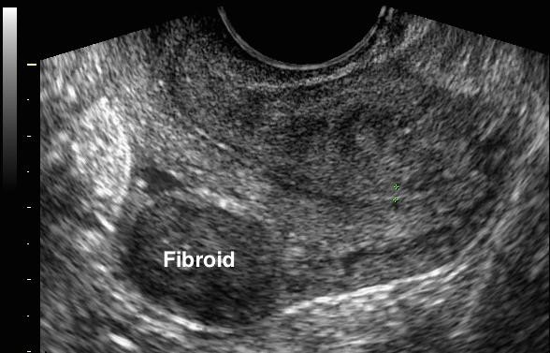
HOW TO INVESTIGATE FOR AETIOLOGY?
ULTRASOUND SCAN
GROWTHS AND INDENTATIONS
FIBROIDS, POLYPS, ADENOMYOSIS
UTERINE ABNORMALITIES

Slide 22
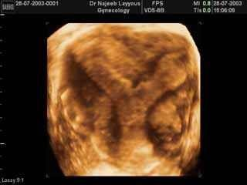
HOW TO INVESTIGATE FOR AETIOLOGY?
ULTRASOUND SCAN
GROWTHS AND INDENTATIONS
FIBROIDS, POLYPS, ADENOMYOSIS
3D SCAN TO ASSESS CAVITY
UTERINE ABNORMALITIES

Slide 23

HOW TO INVESTIGATE FOR AETIOLOGY?
ULTRASOUND SCAN
GROWTHS AND INDENTATIONS
FIBROIDS, POLYPS, ADENOMYOSIS
3D SCAN TO ASSESS CAVITY
HYSTEROSCOPY
UTERINE ABNORMALITIES

Slide 24
HOW TO TREAT INFERTILITY?
SPECIFIC TREATMENT
MYOMECTOMY
POLIPECTOMY
OVUALTION INDUCTION
EMPIRICAL TREATMENT
AUGMENTATION OF OVULATION
INTRAUTERINE INSEMINATION
IN VITRO FERTILISATION

Slide 25
OVULATION INDUCTION / AUGMENTATION
INDUCTION - IN THE PRESENCE OF ANOVULATION
FIND THE UNDERLYING CAUSE
TREAT IF A TREATABLE CAUSE PRESENT
AUGMENT / INDUCE OVULATION BY HORMONAL MANIPULATION
CLOMIFENE / TAMOXIFENE
LETROZOLE
GONADOTROPINS
LAPAROSCOPIC OVARIAN DRILLING (ONLY IN PCOS)

Slide 26
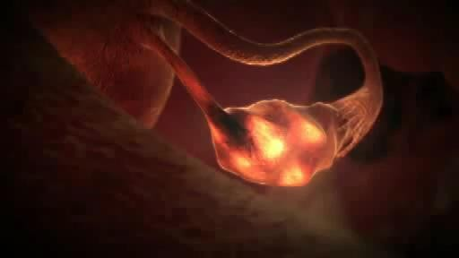
INTRAUTERINE INSEMINATION
INCLUDE VARIOUS STEPS
OVULATION INDUCTION /
AUGMENTATION
TIMING OF OVULATION WITH HCG INJECTION
SPERM PROCESSING
INSEMINATION IN THE UTERINE CAVITY

Slide 27
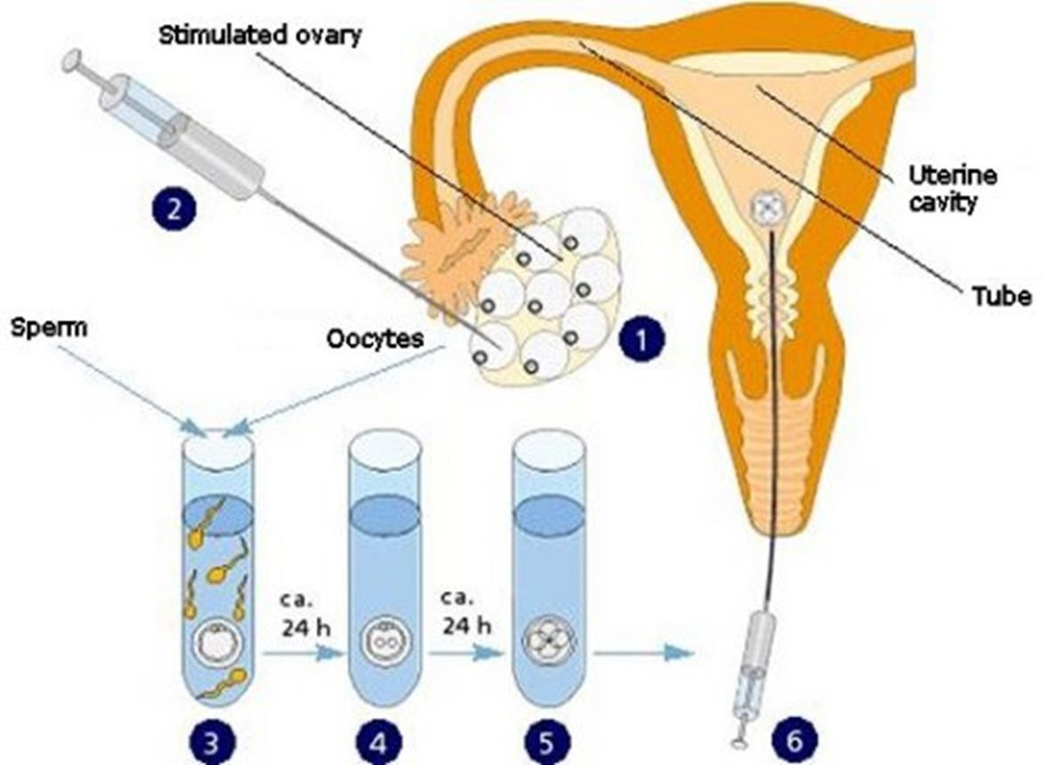
IN VITRO FERTILISATION
INCLUDE THE FOLLOWING STEPS
SUPEROVULATION (10-15 OOCYTES)
OOCYTE RETRIEVAL
SPERM PROCESSING
FERTILISATION OUTSIDE BODY
EMBRYO REPLACEMENT
LUTEAL SUPPORT

Slide 28

IN VITRO FERTILISATION
INCLUDE THE FOLLOWING STEPS
SUPEROVULATION (10-15 OOCYTES)
OOCYTE RETRIEVAL
SPERM PROCESSING
FERTILISATION OUTSIDE BODY
EMBRYO REPLACEMENT
LUTEAL SUPPORT

Slide 29
ICSI-(INTRA CYTOPLASMIC SPERM INJECTION

Slide 30
Other treatment modalities
Gamets donation
Sperm IVI
Oocytes IVF
Embryo donation
SURROGACY

